Slide 1
Android: Animation
David Meredith
dave@create.aau.dk

Slide 2
Source
http://developer.android.com/guide/topics/graphics/index.html

Slide 3
Overview
Animation
Android provides 2 animation systems
Property animation (from API 11, Android 3.0) (preferred – more flexible and offers more features)
View animation
Also drawable animation
For displaying series of Drawable resources (e.g., bitmaps) one after the other

Slide 4
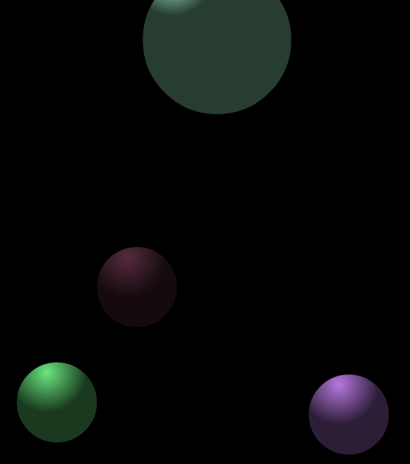
Property Animation
Property animation allows you to animate almost anything
Can change any object property over time regardless of whether it draws to the screen
Changes a property’s value over a specified length of time
To animate a property, specify
property you want to animate (e.g., position)
how long you want to animate for
what values you want to animate between

Slide 5
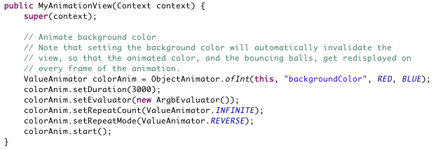
Property animation
Property animation system lets you define
Duration (default is 300ms)
Time interpolation
How property values depend on elapsed time of animation
Repeat count and behaviour
Specify number of times animation should run and whether it should run in reverse
Animator sets
Group animation into logical sets that play together or sequentially
Frame refresh delay
How often to refresh frames of your animation (default 10ms)
Actually depends on how busy system is and how fast system can service the timer

Slide 6
How property animation works
Figure depicts animation of x property of an object
Must travel 40 pixels in 40 ms
Linear interpolation means object moves 10 pixels every 10 ms

Slide 7
Non-linear interpolation
Can also specify non-linear interpolation
Figure shows object that accelerates at beginning of animation and decelerates at the end

Slide 8
How animations are calculated
ValueAnimator keeps track of animation’s timing (e.g., how long it’s been running, current value of animated property)
TimeInterpolator – defines interpolation
e.g., AccelerateDecelerateInterpolator
TypeEvaluator – defines how to calculate values for the animated property
e.g., IntEvaluator

Slide 9
Running an animation
Create a ValueAnimator, specifying
start value of animated property
end value of animated property
duration of animation
Call the ValueAnimator object’s start() method
During animation, ValueAnimator continuously calculates an elapsed fraction between 0 (beginning of animation) and 1 (end of animation period)
e.g., in animation above, 0.25 corresponds to 10 ms

Slide 10
Example
see BouncingBalls.java

Slide 11
Interpolated fractions
ValueAnimator calculates elapsed fraction (i.e., fraction of animation time period elapsed)
Then TimeInterpolator uses elapsed fraction to calculate interpolated fraction
fraction of total change in animated property for this elapsed fraction
e.g., in example above, interpolated fraction is 0.15 when elapsed fraction is 0.25

Slide 12
Calculating the property value
ValueAnimator uses TypeEvaluator to calculate the value of the animated property, based on
the starting value
the interpolated fraction
the ending value
e.g., in above example, property value for interpolated value of 0.15 is 0.15 x (40-0)=6

Slide 13
Limitations of View animation
View animation only allows you to animate View objects
You need to write your own code if you want to animate non-View objects
View animation only lets you animate certain aspects of a View (e.g., scaling and rotation)
View animation only affects where View is drawn, not where it “actually” is
e.g., if you animate a button, the place where you click does not move!

Slide 14
Property vs. View animation
Previous constraints of View animation completely removed
Can animate any property of any object – View or non-View!
Object itself is modified
You assign animators to the properties you want to animate
e.g., color, position, size
You define how animation happens
e.g., interpolations and synchronization of multiple animators

Slide 15
Advantages of View animation
View animation takes less time to set up and needs less code
So use it if it achieves everything you need to do

Slide 16
Property animation API overview
Most of the property animation system’s API is in the android.animation package
http://developer.android.com/reference/android/animation/package-summary.html
You can also use the View animation interpolators in property animation
available in android.view.animation
http://developer.android.com/reference/android/view/animation/package-summary.html

Slide 17
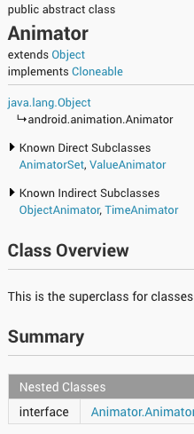
Animators
Animators are used to create animations
usually done by a subclass of Animator
The following subclasses extend Animator
ValueAnimator
main timing engine for property animation
computes values for animated property
contains information about repeats, behaviour, listeners that receive update events
can set custom types to evaluate
only calculates property values
does NOT set values on the animated object
ObjectAnimator
subclass of ValueAnimator
allows target object and property to be set
updates animated property value
used most of the time
requires specific accessors to be available on the target object
AnimatorSet
allows animations to be grouped so that they play together, sequentially or after a delay

Slide 18
Evaluators
Evaluators tell property animation system how to calculate values for animated properties
Calculate animated property values using timing data provided by Animator class and start and end values

Slide 19
Evaluators
Property animation system provides following Evaluators
IntEvaluator – default for calculating int values
FloatEvaluator – default for calculating floats
ArgbEvaluator – default for calculating hexadecimal colour values
TypeEvaluator – interface that lets you create your own evaluator if type of animated property is not int, float or colour
Can also use for custom evaluator of int, float or colour

Slide 20
Interpolators
Interpolator defines how animated property values in an animation are calculated as a function of time, e.g.,
linear interpolator – constant rate of animated property value change throughout
or non-linear – e.g., accelerating at the beginning, decelerating at the end

Slide 21
Interpolators
Interpolators provided by android.view.animation
AccelerateDecelerateInterpolator – rate increases then decreases
AccelerateInterpolator – rate increases
AnticipateInterpolator – rate starts backward then flings forward
AnticipateOvershootInterpolator – rate starts backwards, flings forward, overshoots and returns to target end value
BounceInterpolator – change bounces at the end
CycleInterpolator – repeats for a specified number of cycles
DecelerateInterpolator – rate decreases
LinearInterpolator – constant rate
OvershootInterpolator – flings forwards, overshoots and returns to target end value
TimeInterpolator – interface for defining your own interpolator
Can implement your own interpolator by implementing TimeInterpolator interface

Slide 22
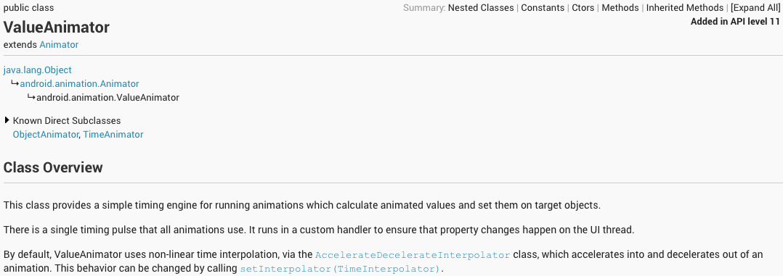
Animating with ValueAnimator
ValueAnimator lets you define a range of int, float or colour values to animate through
Get a ValueAnimator by calling one of its factory methods
ofInt(), ofFloat() or ofObject()
See above

Slide 23
Animating with ValueAnimator
ValueAnimator animation = ValueAnimator.ofObject(
new MyTypeEvaluator(),
startPropertyValue, endPropertyValue); animation.setDuration(1000); animation.start();
Can also specify a custom type to animate
see above
Here, ValueAnimator calculates values between startPropertyValue and endPropertyValue, using MyTypeEvaluator()

Slide 24
Animation Listeners
ValueAnimator does not set values in animated object properties
Only computes values
Define AnimatorUpdateListeners in ValueAnimator to handle important events during the animation (e.g., frame updates)
Need to implement onAnimationUpdate(ValueAnimator animation)
Get calculated value for the current frame refresh by calling ValueAnimator’s getAnimatedValue() method

Slide 25
Animating with ObjectAnimator
ObjectAnimator is a subclass of ValueAnimator
Combines timing and calculation functionality of ValueAnimator with ability to set values in animated properties
No need to define AnimatorUpdateListeners
Create an ObjectAnimator by using one of the factory methods and passing
object
property (as a String)
starting and ending value of animated property
See above

Slide 26
Using an ObjectAnimator
In order for the ObjectAnimator to update properties correctly
Object property must have a setter in camel case of form “set<propertyName>
e.g., must be a “setFoo()” method if property is “foo”
If you don’t have such a setter, you can
implement one
define a wrapper class that has one and forwards value to the original object
use a ValueAnimator and define an AnimatorUpdateListener

Slide 27
Using an ObjectAnimator
If you only specify ending value of animation when constructing an ObjectAnimator then
object property must have a getter function, “get<propertyName>” to get the start value
e.g., “getFoo()” if property name is “foo”

Slide 28
Using an ObjectAnimator
Return type of getter and argument type of setter must be the same as the type of the starting and ending values you specify when constructing the ObjectAnimator
e.g., in example above
targetObject.getPropName() returns a float
targetObject.setPropName(float f) is passed a float

Slide 29
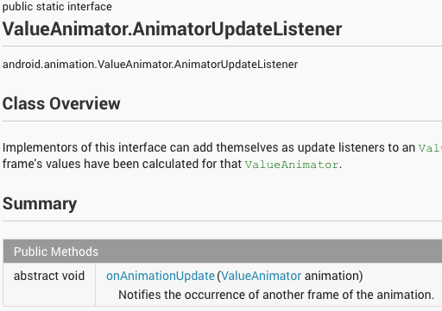
Forcing a screen redraw
Depending on animated property, you may need to call View.invalidate() on a View to redraw the screen when animated values are updated
Do this in
ValueAnimator.AnimatorUpdateListener.onAnimationUpdate(ValueAnimator)
e.g., if change colour of a Drawable object, must wait for object to redraw itself
All property setters on View invalidate the View and cause it to be redrawn

Slide 30
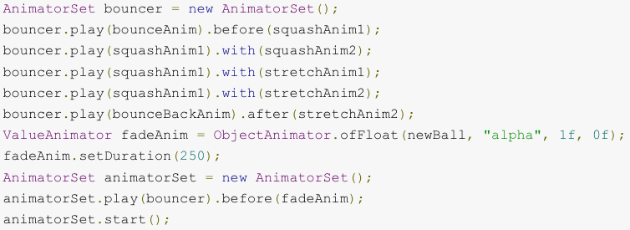
Using AnimatorSet
When you play an animation may depend on when another one starts or finishes
AnimatorSet lets you bundle animations together and start them
simultaneously
sequentially
after a specified delay
AnimatorSets can be nested, one inside the other

Slide 31
Example of an AnimatorSet
Example plays Animator objects in the following manner:
Plays bounceAnim
Plays squashAnim1, squashAnim2, stretchAnim1 and stretchAnim2 at the same time
Plays bounceBackAnim
Plays fadeAnim

Slide 32
Example
Bouncing Ball demo

Slide 33
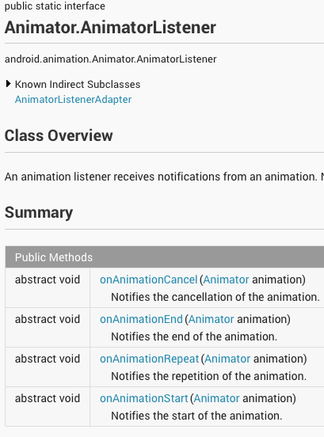
Animation Listeners
During an animation, you can listen for important events using these listeners:
Animator.AnimatorListener
onAnimationStart() – called when animation starts
onAnimationEnd() – called when animation ends
onAnimationRepeat() – called when animation repeats
onAnimationCancel() – called when animation canceled
onAnimationEnd() also called
ValueAnimator.AnimatorUpdateListener
onAnimationUpdate() – called on every frame
implement to use values calculated by ValueAnimator
call valueAnimator.getAnimatedValue() on ValueAnimator passed to this callback
must implement this listener if using ValueAnimator

Slide 34
AnimatorListenerAdapter
AnimatorListenerAdapter provides empty implementations of AnimatorListener methods
So you don’t have to implement all the methods in AnimatorListener – just override the ones that are necessary
e.g., Bouncing Balls sample creates AnimatorListenerAdapter just for onAnimationEnd() callback
see BouncingBalls.java, line 136

Slide 35
Animating layout changes to ViewGroups
Property animation allows ViewGroups to be animated (not just Views)
Use LayoutTransition class to animate layout changes
Views inside a ViewGroup can go through an appearing or disappearing animation when
added to or removed from a ViewGroup
when setVisibility() method called

Slide 36
LayoutTransition
Use LayoutTransition.setAnimator(int transitionType, Animator animator) and use one of the following LayoutTransition constants
APPEARING – indicates animation running on items appearing in the container
CHANGE_APPEARING – animation runs on items changing because a new item is appearing
DISAPPEARING – animation rungs on items disappearing from container
CHANGE_DISAPPEARING – animation runs on items changing due to item disappearing from container
Can define custom animations or use system defaults

Slide 37
Example
See LayoutAnimations sample

Slide 38
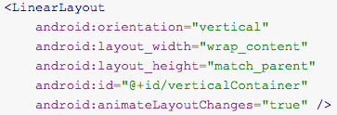
Enabling default layout transitions
LayoutAnimationsByDefault sample and its layout resource file show how to enable default layout transitions for ViewGroups in XML
Just set android:animateLayoutChanges attribute to true – see above
This automatically animates Views added to or removed from ViewGroup as well as remaining Views in the ViewGroup

Slide 39
Example
See LayoutAnimationsByDefault sample

Slide 40
Using a TypeEvaluator
Make your own implementation of the TypeEvaluator interface if you need to animate a type other than int, float or color
TypeEvaluator declares one method:
evaluate()
Must allow the animator to return a correct value for your animated property at the current point in the animation
See FloatEvaluator class above
Note that evaluate receives interpolated fraction (not elapsed fraction)

Slide 41
Using interpolators
Interpolator defines how value in an animation are calculated as a function of elapsed time
animations may proceed linearly at a constant rate
or the rate at which they proceed may change over the duration of the animation
Interpolators receive elapsed fraction from Animator and convert it into an interpolated fraction
Android provides interpolators in
android.view.animation package
Can also make your own by implementing TimeInterpolator interface

Slide 42
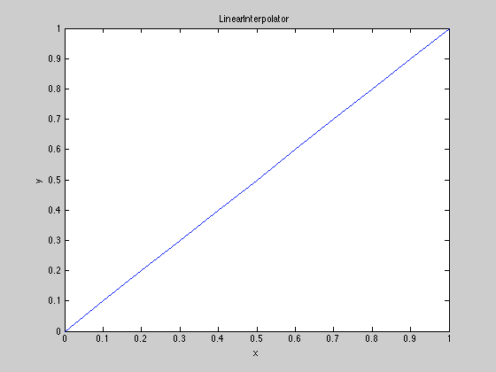
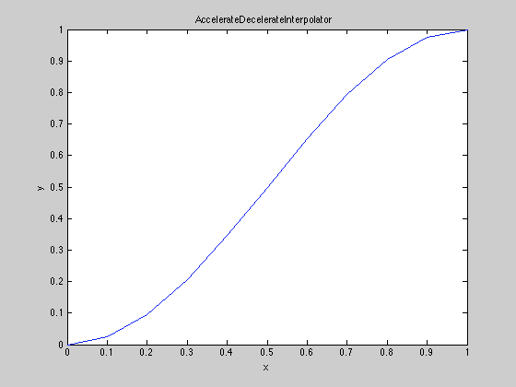
Example
LinearInterpolator returns elapsed fraction
AccelerateDecelerateInterpolator accelerates into animation and decelerates out of it (see above)

Slide 43
PropertyValuesHolder
PropertyValuesHolder used to hold information about an animated property
Can be used to create animations with ValueAnimator or ObjectAnimator that operate on several different properties in parallel

Slide 44
Keyframes
Keyframe is a time-value pair that specifies a particular value at a particular time during the animation
Each keyframe can have an interpolator controlling change rate over period since preceding keyframe
Keyframe constructed by factory method
ofInt(), ofFloat(), ofObject()
e.g., Keyframe.ofFloat(.5f, 360f)
Then use PropertyValuesHolder.ofKeyFrame() to get a PropertyValuesHolder object
Can get ObjectAnimator by passing target object and PropertyValuesHolder to the ObjectAnimator

Slide 45
Example
MultiPropertyAnimation sample in API demos

Slide 46
Animating Views
View animation transforms objects by changing the way they are drawn without changing the objects themselves
causes view object to be in constant position even though drawn in a different place on the screen
Property animation animates views by changing their properties – i.e., changing the objects themselves, not just how they are drawn

Slide 47
Changes to the View class to support property animation
translationX, translationY
vector from original position of View to current position
rotation, rotationX, rotationY
controls rotation in 2D (rotation) and 3D (rotationX, rotationY)
scaleX, scaleY
2D scaling of View around a pivot point
pivotX, pivotY
location of pivot point for rotation and scaling
x, y
final location of View
alpha
transparency: 0 = opaque; 1=invisible.

Slide 48
Animating Views
To animate a View property, e.g., color or rotation,
create a property animator
specify the View property that you want to animate

Slide 49
Animating with ViewPropertyAnimator
Use a ViewPropertyAnimator if you want to animate many properties of an object at once
more efficient and leads to shorter code
Works like an ObjectAnimator – updates values, doesn’t just compute them

Slide 50
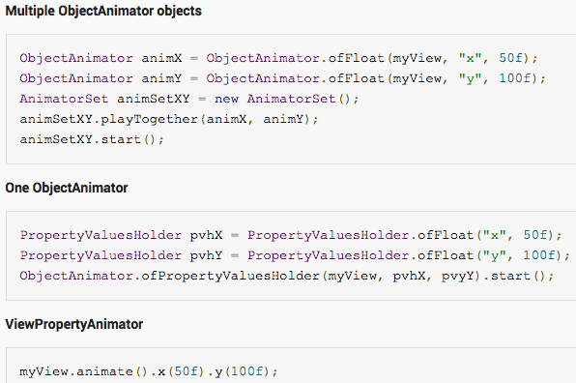
Example of using ViewPropertyAnimator

Slide 51
Declaring animations in XML
Can define property animations in XML instead of programmatically
lets you reuse your animations more easily
lets you edit the animation sequence more easily
Animations that use the legacy View animation API should be stored in res/anim
Animations using the new property animation API should be stored in res/animator
Eclipse ADT plugin only looks in res/animator

Slide 52
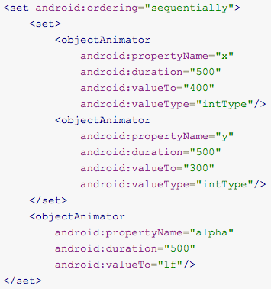
Declaring animations in XML
XML tags for animation classes:
ValueAnimator: <animator>
ObjectAnimator: <objectAnimator>
AnimatorSet: <set>
On left, plays a set of two object animations together and then a single object animator afterwards

Slide 53
Declaring animations in XML
In order to run previous XML animation, must inflate it to an AnimatorSet and set target objects for all animations before starting the set
setTarget() sets a single target object for all children of the AnimatorSet
See code

